Slide 1

Final Project Presentation
Professor: Mrudala Mukada
Students:
1. Ngoc But Bui
2. Van An Vu
3. Ha Vu Duy Nguyen
4. Hong Huan Nguyen
Big Data Technology
09/2024

Slide 2
GitHub
https://github.com/butbuiapp/data-analysis/tree/main
Recording
https://mum0-my.sharepoint.com/:v:/r/personal/honghuan_nguyen_miu_edu/Documents/Microsoft%20Teams%20Chat%20Files/BDT.mp4?csf=1&web=1&e=97UFnI

Slide 3
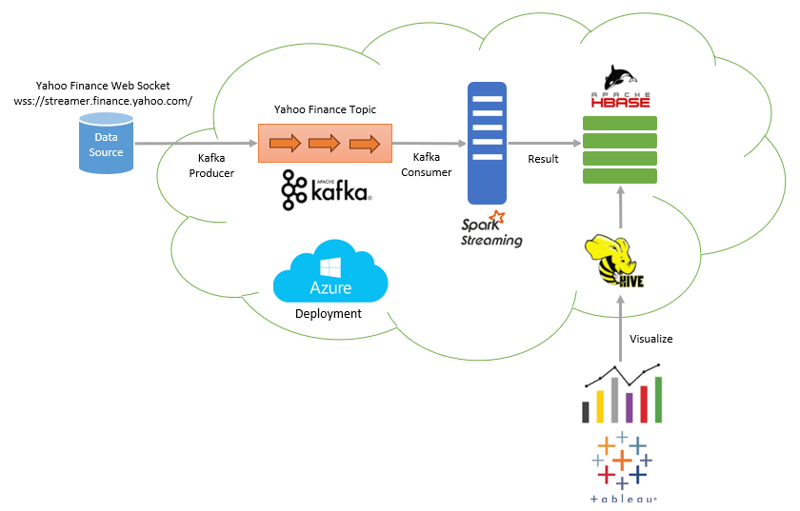
Project Architecture

Slide 4
Technologies used
Technology | Version
Ubuntu | 22.04
Hadoop | 3.3.6
Spark | 3.5.2
HBase | 2.60
Kafka | 2.13-3.8.0
Maven | 3.8.8
OpenJDK | 1.8.0_422
Hive

Slide 5
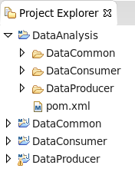
Project Structure
Project | Description
DataCommon | Hold common configurations, objects and functionalities
DataProducer | Connect to Yahoo Finance Web Socket to get data and publish data to Kafka
DataConsumer | Subscribe to Kafka using Spark Streaming to consume data and store data to HBase.

Slide 6
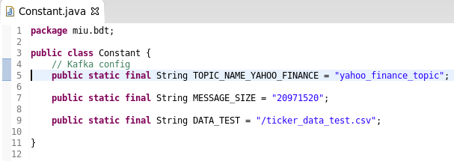
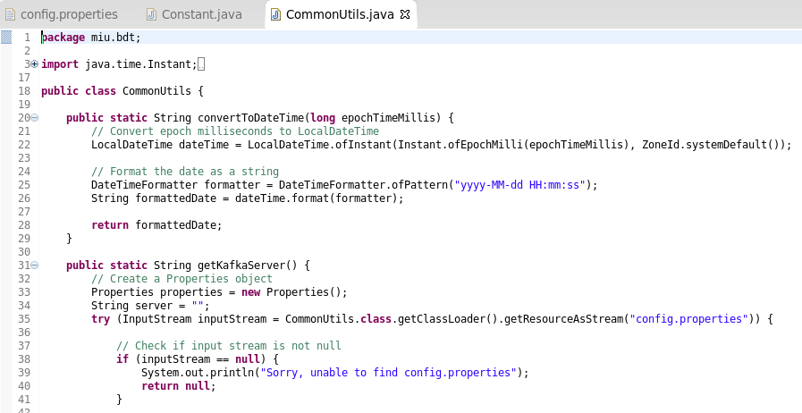
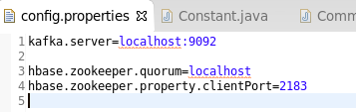
DataCommon Project

Slide 7
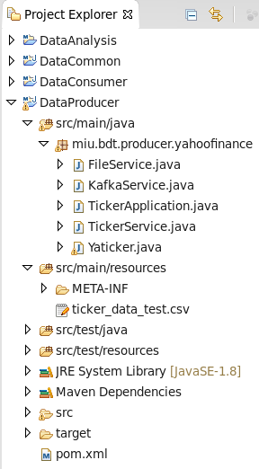
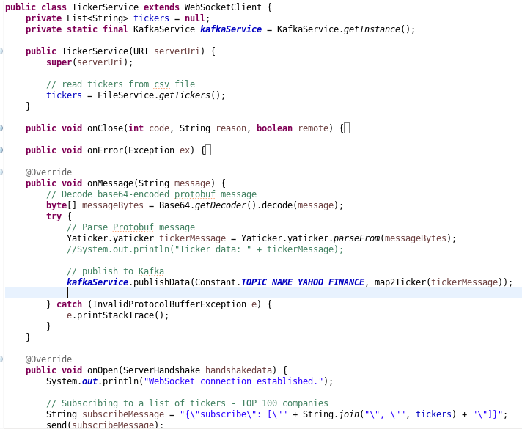
DataProducer Project
*** Test data is stored in CSV format in DataProducer/src/main/resources/ticker_data_test.csv

Slide 8
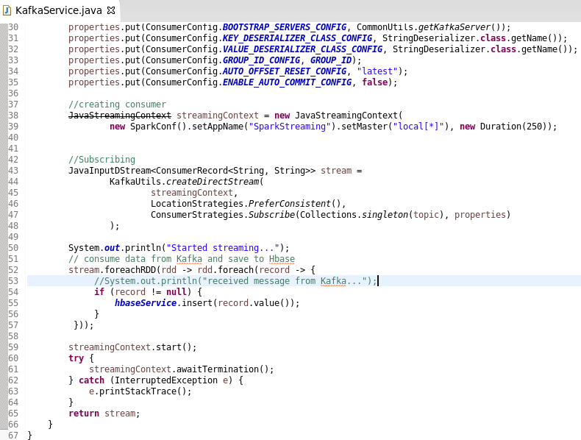
DataConsumer Project

Slide 9

Application Demo
*** This demo will be run on Azure environment

Slide 10
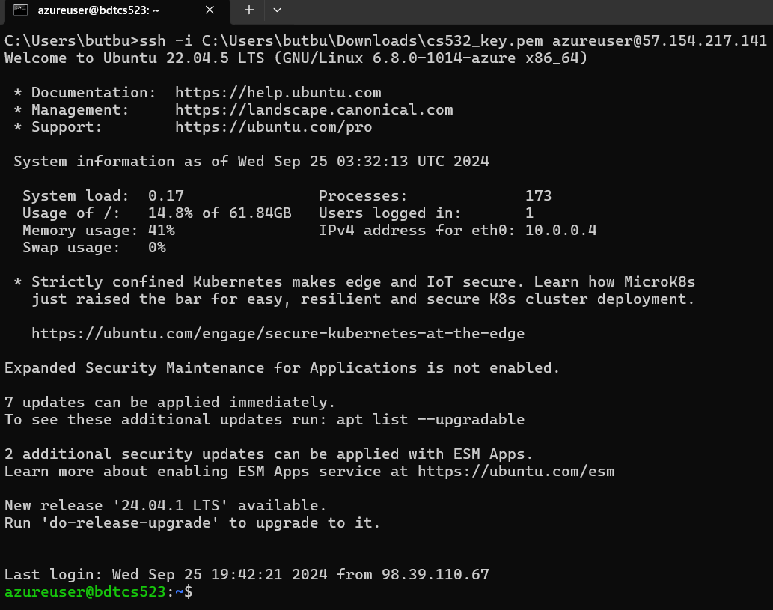
Application Demo
Connect to Ubuntu on Azure
Open a terminal and run the command below
ssh -i C:\Users\butbu\Downloads\cs532_key.pem azureuser@57.154.217.141

Slide 11
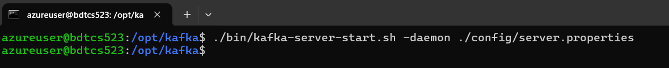
Application Demo
Start Kafka
Go to Kafka installation folder and run
./bin/kafka-server-start.sh -daemon ./config/server.properties

Slide 12
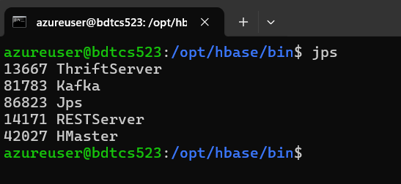
Application Demo
Start HBase
Go to HBase installation folder and run
./bin/start-hbase.sh
Run jps command to check if all services are running

Slide 13
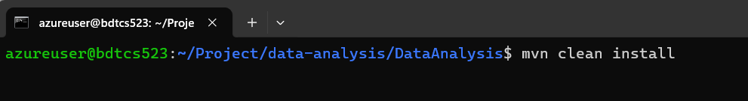
Application Demo
Build Java projects
Go to the root project (DataAnalysis) and run
mvn clean install

Slide 14
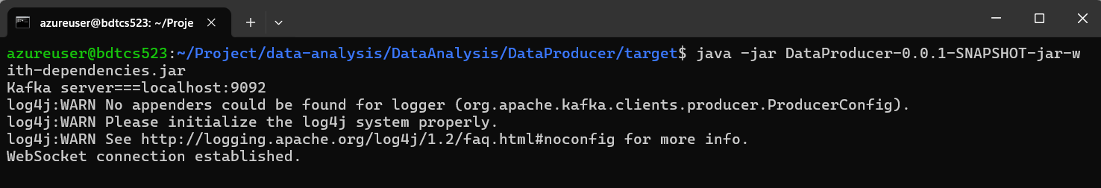
Application Demo
Run DataProducer
Go to DataProducer project and run
java -jar DataProducer-0.0.1-SNAPSHOT-jar-with-dependencies.jar

Slide 15
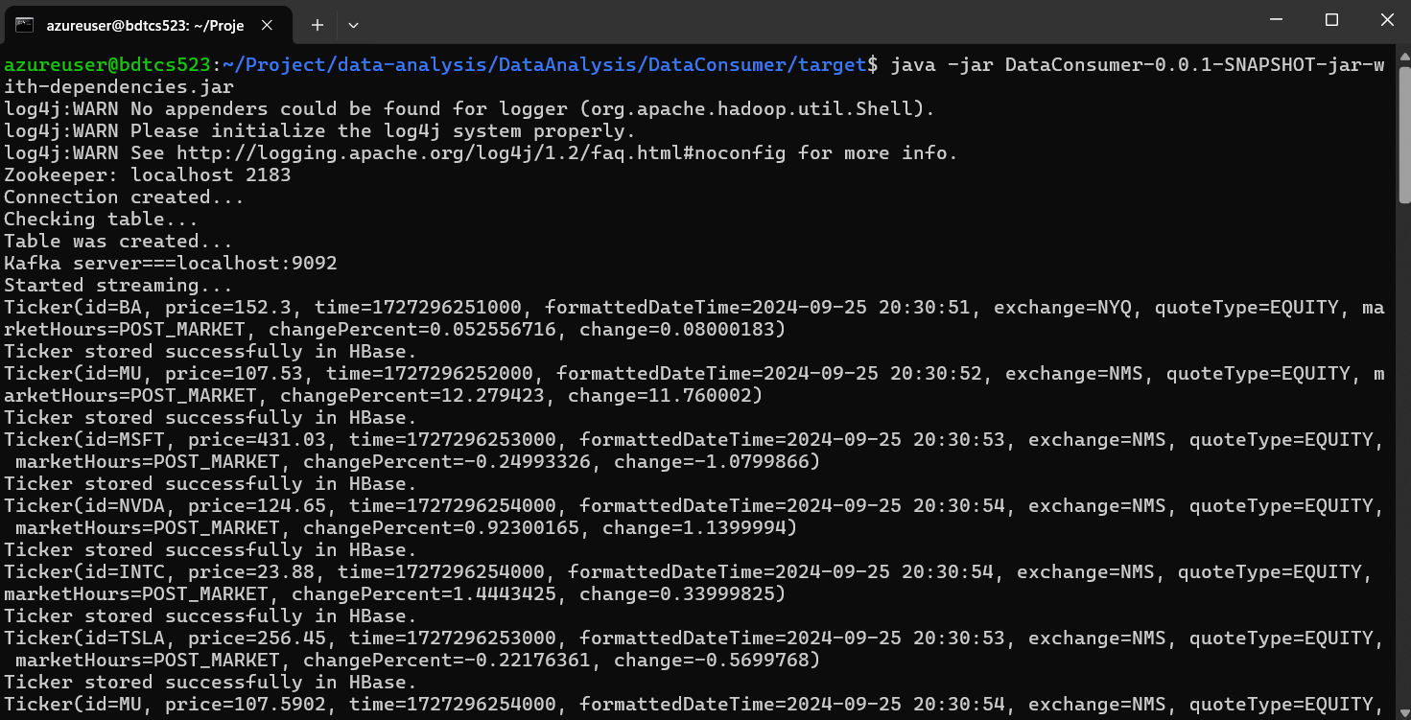
Application Demo
Run DataConsumer
Go to DataConsumer project and run
java -jar DataConsumer-0.0.1-SNAPSHOT-jar-with-dependencies.jar

Slide 16
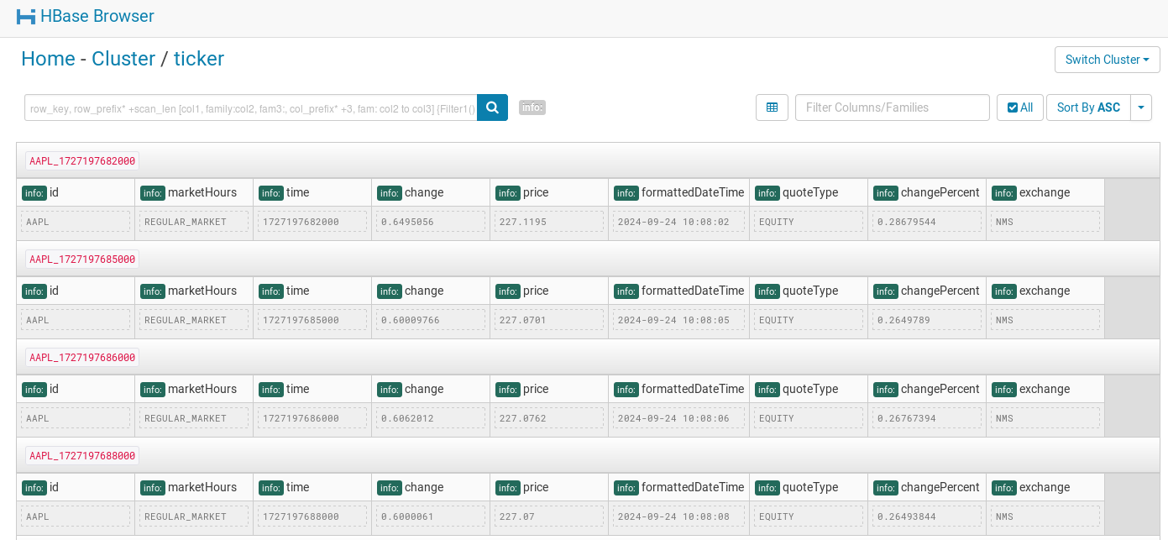
Application Demo
Check data in HBase
Go to Hbase shell
>hbase shell
Show tables
hbase>list
Show data
hbase>scan ‘ticker’
The data stored in HBase like this (screenshot on Cloudera QuickStart VM)

Slide 17

Visualization Demo
*** This demo will be run locally, connecting to Cloudera QuickStart VM

Slide 18
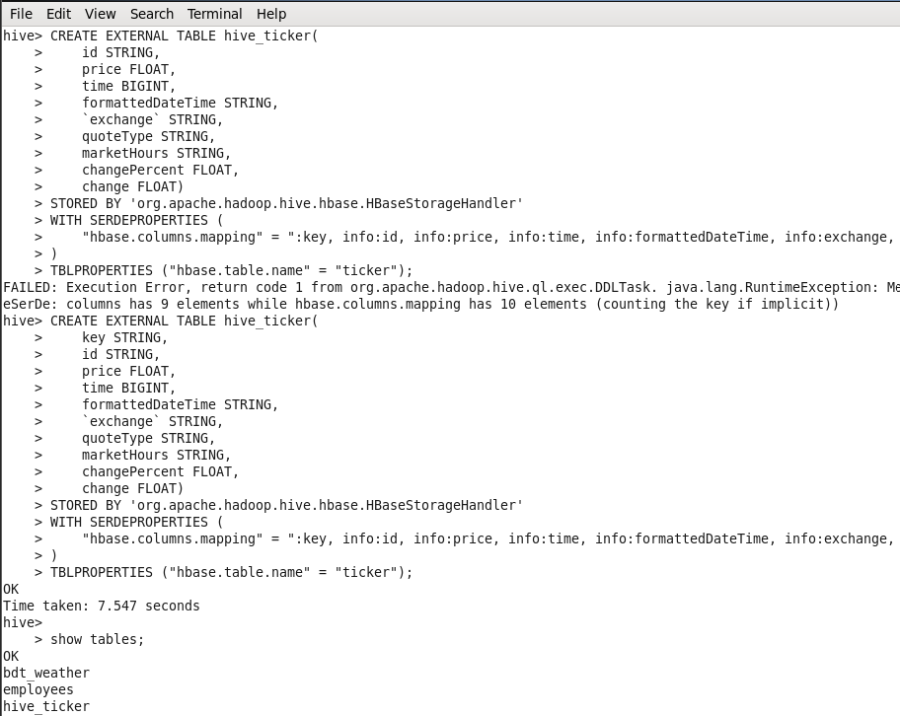
Visualization Demo
CREATE EXTERNAL TABLE hive_ticker(
key STRING,
id STRING,
price FLOAT,
time BIGINT,
formattedDateTime STRING,
`exchange` STRING,
quoteType STRING,
marketHours STRING,
changePercent FLOAT,
change FLOAT)
STORED BY 'org.apache.hadoop.hive.hbase.HBaseStorageHandler'
WITH SERDEPROPERTIES (
"hbase.columns.mapping" = ":key, info:id, info:price, info:time, info:formattedDateTime, info:exchange, info:quoteType, info:marketHours, info:changePercent, info:change"
)
TBLPROPERTIES ("hbase.table.name" = "ticker");
Go to Hive shell
>hive
Create a table in Hive on top of HBase table

Slide 19
Visualization Demo
Download and install Cloudera Hive ODBC Driver
https://www.cloudera.com/downloads/connectors/hive/odbc/2-7-0.html
Download and install Tableau Desktop Pro
https://www.tableau.com/academic/students
*** Tableau Desktop Public does not support connection to Cloudera Hadoop
*** Students are eligible for a free one-year license to activate Tableau Desktop and Tableau Prep

Slide 20
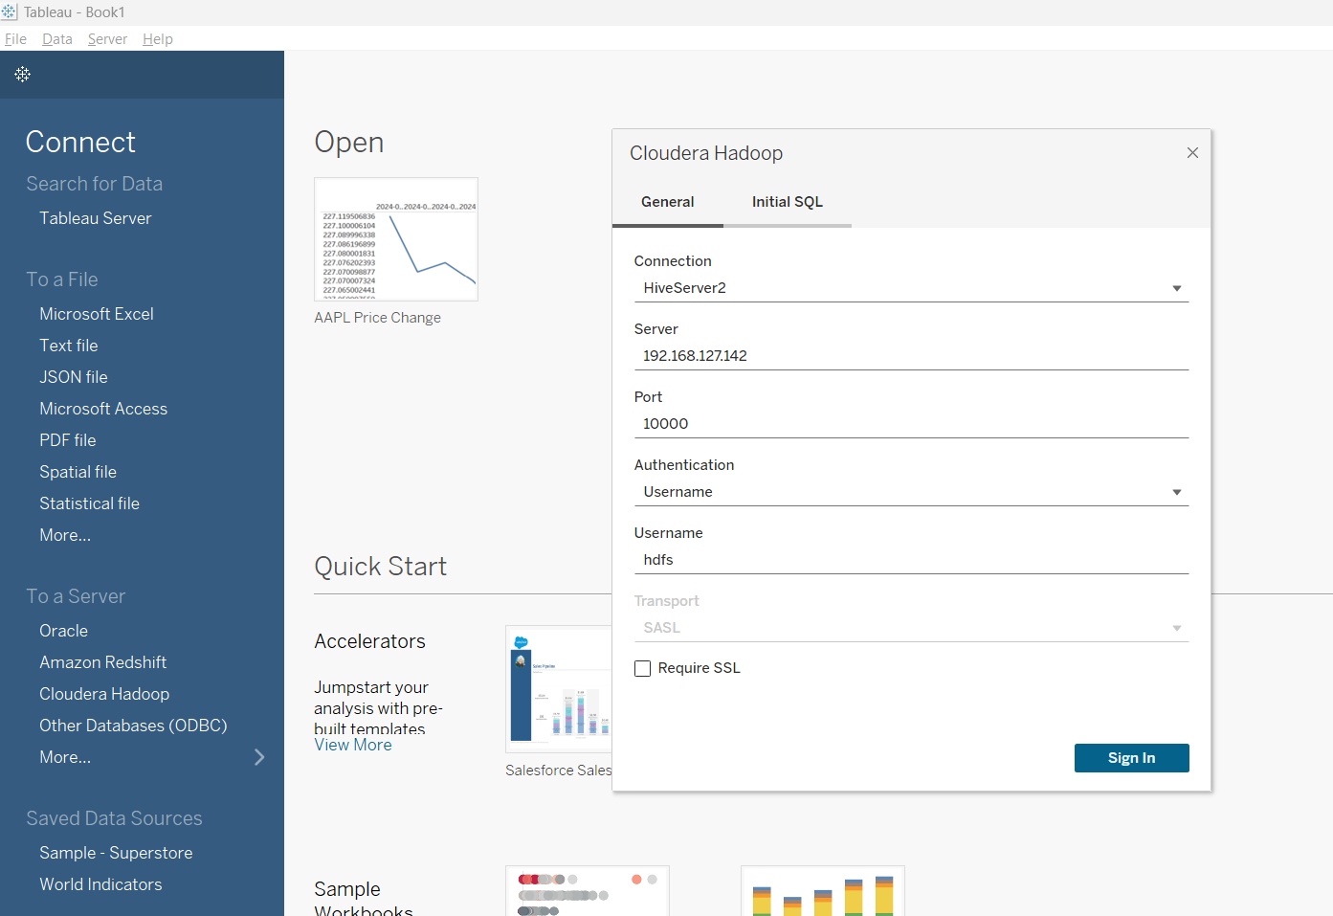
Visualization Demo
Open Tableau Desktop and connect to Hive via Cloudera Hadoop connector

Slide 21
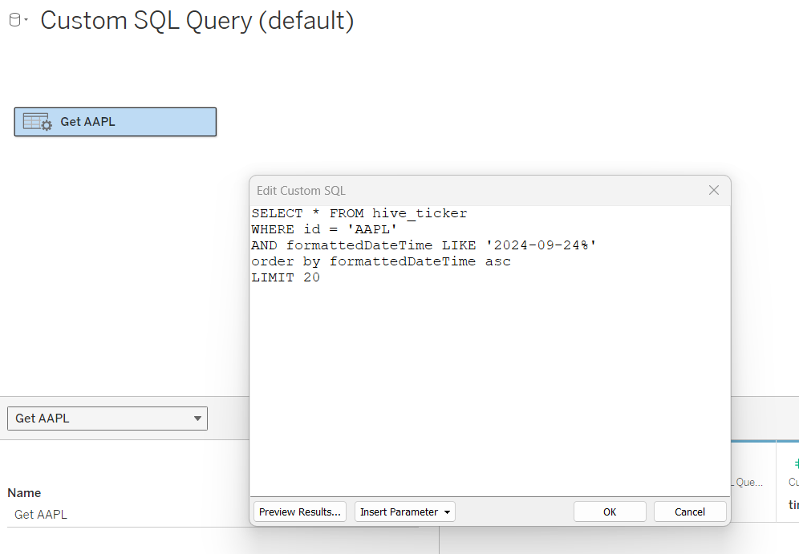
Visualization Demo
Use Custom SQL Query to get data from Hive

Slide 22
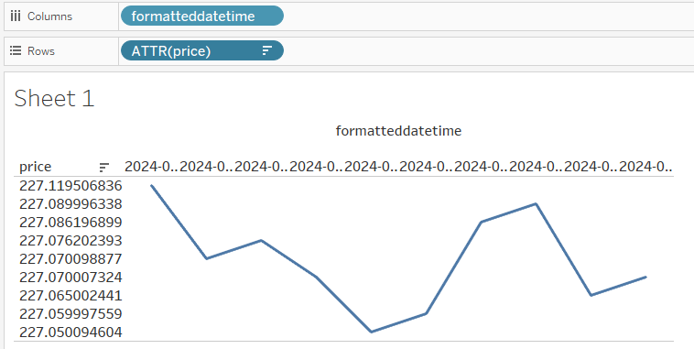
Visualization Demo
Build chart

Slide 23
Thank you
Github
https://github.com/butbuiapp/data-analysis/tree/main
Recording
https://mum0-my.sharepoint.com/:v:/r/personal/honghuan_nguyen_miu_edu/Documents/Microsoft%20Teams%20Chat%20Files/BDT.mp4?csf=1&web=1&e=97UFnI

